Slide 1

Audio for VR
CS 498VR: Virtual Reality
UNIVERSITY OF ILLINOIS AT URBANA-CHAMPAIGN
Based on material from: Bruce Thomas and Mark Billinghurst
University of South Australia
Eric Shaffer

Slide 2
Audio Displays
Definition: Audio displays are computer interfaces that provide synthetic sound feedback to users interacting with the virtual world.
The sound can be monaural (both ears hear the same sound), or binaural (each ear hears a different sound)

Slide 3
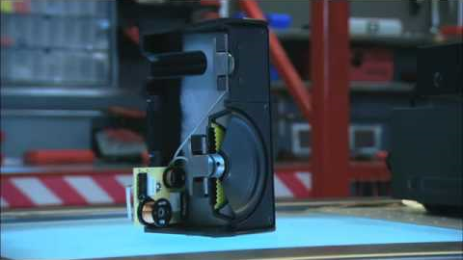
How Speakers Work

Slide 4
Motivation for Audio
In VR users want more realism and complexity and performance
Sound can significantly enhance realism
Example: Forest sounds when traveling through a virtual woods
Sound can enhance user experience
Example: Mood music in horror games
Sound can provide valuable user interface feedback
Example: Alert in training simulation

Slide 5
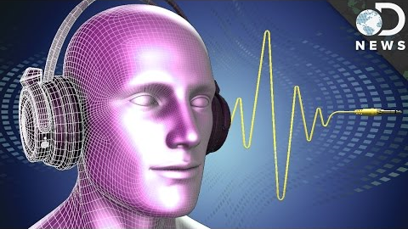
Virtual Reality Audio Overview

Slide 6
Acquiring Audio Assets
Sounds can be captured or synthesized
Recorded sounds
Cheap to play
Easy to create realism
Expensive to store and move
Difficult to manipulate
Synthetic Sounds
Cheap to store and move
Easy to manipulate
Expensive to synthesize
Realism difficult

Slide 7
Types of Audio Recordings
Monaural: One microphone, no positioning
Stereo: Two microphones, several feet apart Perceived sound position as recorded by microphones
Binaural: Microphones embedded in dummy head. Audio filtered by head shape
3D: Microphones in ears of actual person. Generate a HRTF based on ear shape and audio response

Slide 8
Synthetic Sound Production
Complex sounds can be built from simple waveforms
e.g. sawtooth, sine, etc.
waveform parameters (frequency, amplitude) could be from motion data, e.g. object velocity
can combine wave forms in various ways
this is what classic synthesizers do
works well for many non-speech sounds

Slide 9
Digital Audio Workstation Software
Software for recording, editing, producing audio files Mixing console, synthesizer, waveform editor, etc
Wide variety available https://en.wikipedia.org/wiki/Digital_audio_workstation

Slide 10
Audio Display Properties
Presentation Properties
Number of channels
Localization
Masking
Amplification
Logistical Properties
Noise pollution
User mobility
Tracking interface
Throughput
Cumber

Slide 11
Channels and Masking
Number of channels can be thought of as the number of audio sources Stereo → 2 channels Quadrophonic → 4 channels Surround → 6 channels
Masking Loud sounds mask softer sounds Physical objects mask sounds signals …obviously not with headphones

Slide 12
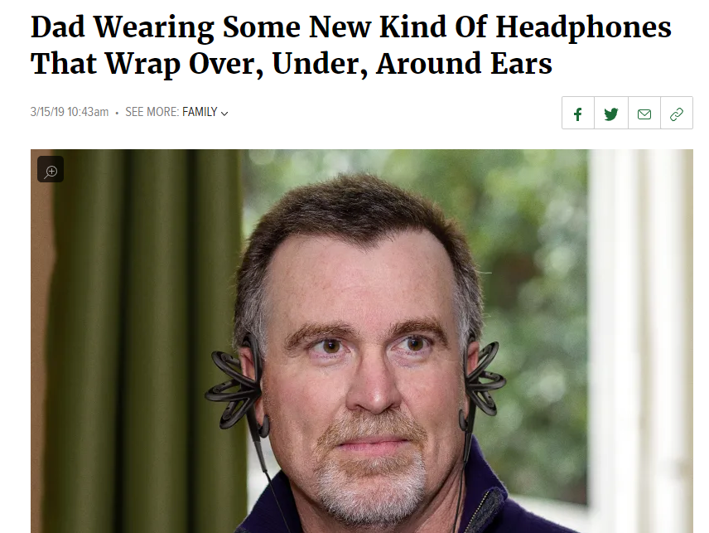
Audio Displays: Head-Worn
From The Onion

Slide 13
Audio Displays: Room Mounted

Slide 14
Spatialization and Localization
Spatialization processing sound signals to make them emanate from a point in space
Localization is the ability of people to identify the source position of a sound

Slide 15
Stereo Sound
Seems to come from inside users head
Follows head motion as user moves head

Slide 16
3D Spatial Sound
Seems external to the head
Fixed in space when user moves
Has reflected sound properties

Slide 17
Spatialized Audio Effects
Naïve approach
• Simple left/right shift for lateral position
• Amplitude adjustment for distance
• Easy to produce using consumer hardware/software
Does not give us "true" realism in sound
• No up/down or front/back cues
We can use multiple speakers for this
• Surround the user with speakers
• Send different sound signals to each one

Slide 18
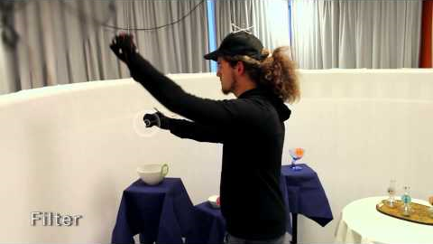
Example: BoomRoom

Slide 19
Audio Localization
Main cues used by humans to localize sound:
Interaural time differences: Time difference for sound wave to travel between ears
Interaural level differences: For high frequency sounds (> 1.5 kHz), volume difference between ears used to determine source direction
Spectral filtering done by outer ears: Ear shape changes frequency heard

Slide 20
Interaural Time Difference
• Takes fixed time to travel between ears
• Can use time difference to determine sound location

Slide 21
Spectral Filtering
Ear shape filters sound depending on direction it is coming from.
This change in frequency determines sound source elevation.

Slide 22
Natural Hearing vs. Headphones
In natural hearing, ear shape provides different audio response depending on sound location

Slide 23
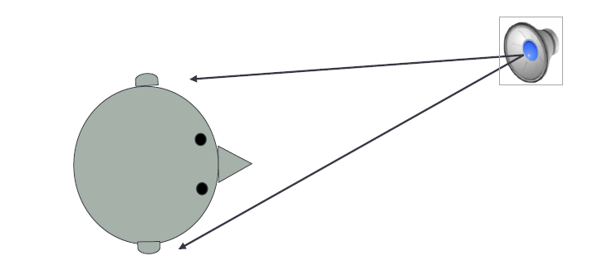
Head-Related Transfer Functions
HRTFs Definition:
functions that model how sound from a given location reaches the eardrum

Slide 24
HRTFs
Functions take into account,
• Individual ear shape
• Slope of shoulders
• Head shape
So, each person has his/her own HRTF!
• Need to have a parameterizable HRTFs
• Some sound cards/APIs allow specifying an HRTF

Slide 26
Constructing HRTFs
• Small microphones placed into ear canals
• Subject sits in an anechoic chamber
• Can use a mannequin's head instead
• Sounds played from a large number of locations around the chamber
• HRTFs are constructed for this data
• Sound signal filtered through inverse functions to place sound at desired source

Slide 27
Using HRTFs
HRTF is the Fourier transform of the in-ear microphone audio response HRIR = head related impulse response
From HRTF we calculate pairs of finite impulse response (FIR) filters for specific sound positions
One filter per ear
To place virtual sound at a position, apply set of FIR filters for that position to the incoming sound

Slide 28
HRTF processing

Slide 29
Environmental Effects
Sound is also changed by objects in the environment
• Can reverberate off of reflective objects
• Can be absorbed by objects
• Can be occluded by objects
Doppler shift
• Moving sound sources
Need to simulate environmental audio properties
• Takes significant processing power

Slide 30
Sound Reverberation
• Need to consider first and second order reflections
• Need to model material properties, objects in room, etc

Slide 31
Audio Processing: It turns out this is difficult
All of this takes a lot of processing
• Need to keep track of
• Multiple (possibly moving) sound sources
• Path of sounds through a dynamic environment
• Position and orientation of listener(s)
Most sound cards only support a limited number of spatialized sound channels
Increasingly complex geometry increases load on audio system as well as visuals
• That's why we fake it
• GPUs might change this

Slide 32
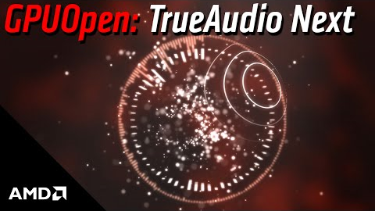
GPU Based Audio Processing

Slide 33
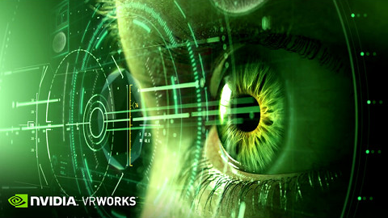
GPU Based Audio Processing

Slide 34
Audio SDKs
Modern CPUs are fast enough to generate some spatial audio effects
Several 3D audio SDKs exist:
OpenAL
• www.openal.org
• Open source, cross platform
• Renders multichannel three-dimensional positional audio
Google VR SDK
• Android, iOS, Unity
• https://developers.google.com/vr/concepts/spatial-audio
Oculus
• https://developer3.oculus.com/documentation/audiosdk/latest/
• Microsoft DirectX, Unity, etc

Slide 35
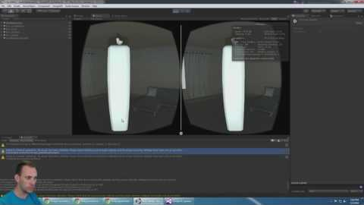
Google VR and Unity

